Slide 1
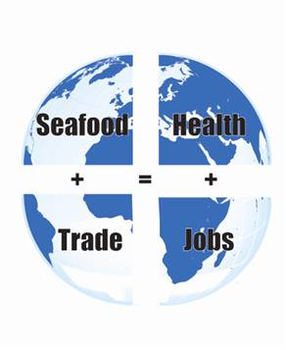
FDA: Food Safety
2011 World Seafood Congress
Charlotte A. Christin
Senior Policy Advisor
U.S. Food and Drug Administration
Sponsors

Slide 2
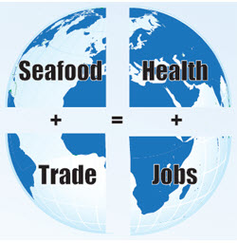
Food Safety Modernization Act
Signed January 4, 2011
Most significant update to FDA food authorities since 1938
New, prevention-oriented system
Broad prevention mandate and accountability;
New system of import oversight
Built on partnerships
2011 World Seafood Congress, October 3-5, 2011, Washington, D.C.

Slide 3
FSMA Themes
Prevention
Enhanced Partnerships
Inspections, Compliance,
and Response
Import Safety
2011 World Seafood Congress, October 3-5, 2011, Washington, D.C.

Slide 4
Prevention
New preventive controls provision
Seafood HACCP firms expressly exempted
Produce safety standards
Intentional adulteration
Sanitary transportation
Performance standards
2011 World Seafood Congress, October 3-5, 2011, Washington, D.C.

Slide 5
Inspections, Compliance, Response
Mandated inspection frequency
Domestic: frequency based on risk
Foreign: 600/yr doubling each yr/5 yrs (19K)
New tools
Mandatory recall, traceability pilots
Expanded records access, detention authority
Suspension of registration
Accredited laboratory testing
2011 World Seafood Congress, October 3-5, 2011, Washington, D.C.

Slide 6
Imports
Foreign supplier verification
Importer must verify supplier preventive controls
Third-party certification
FDA-Recognized accreditation bodies
Accredited “auditors” (certification bodies)
Food safety audits of eligible foreign firms
Certifications of food, facilities
2011 World Seafood Congress, October 3-5, 2011, Washington, D.C.

Slide 7
Imports
Voluntary qualified importer program
In addition to mandatory FSVP requirements
Participants must have foreign facility certification
Expedited review and entry
Mandatory certification
Risk-related determination: food, area of origin
Certification required for certain imported food
2011 World Seafood Congress, October 3-5, 2011, Washington, D.C.

Slide 8
Imports
Capacity building
Plan required
Seeking to leverage efforts
Comparability
Public hearing in March 2011
Assesses comparability of foreign food regulatory systems
2011 World Seafood Congress, October 3-5, 2011, Washington, D.C.

Slide 9
Partnerships
Reliance on other regulators’ inspections
State/local/foreign capacity building
Improved food borne illness surveillance
Consortium of laboratory networks
National ag and food defense strategy
2011 World Seafood Congress, October 3-5, 2011, Washington, D.C.

Slide 10
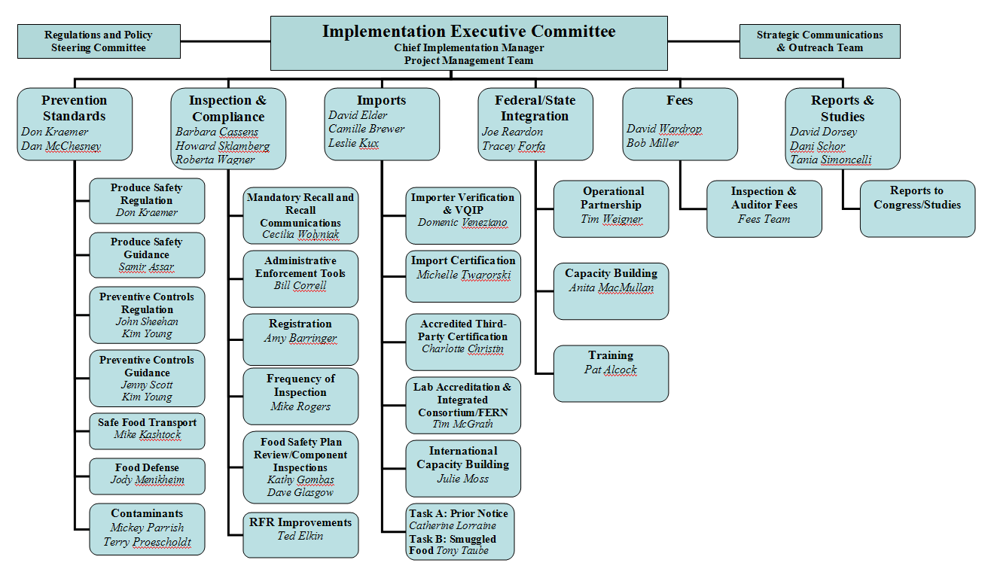
2011 World Seafood Congress, October 3-5, 2011, Washington, D.C.

Slide 11
FSMA: Challenges and Opportunities
50 rules/guidance/reports in 3 years
Tight statutory deadlines
Stakeholder input, transparency are key
Changes will take long-term effort
Resources
2011 World Seafood Congress, October 3-5, 2011, Washington, D.C.

Slide 12
For more information
www.fda.gov
FSMA link on home page
Subscribe to FSMA updates by email
www.foodsafety.gov
2011 World Seafood Congress, October 3-5, 2011, Washington, D.C.

